Slide 1
Recurrent neural network (RNN) Reference Lecture

Slide 2
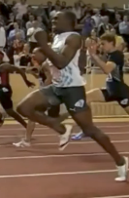
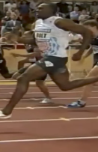
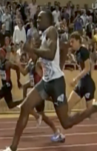
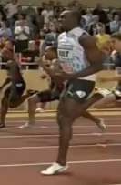
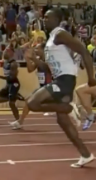

Examples of sequence data
“The quick brown fox jumped over the lazy dog.”
Speech recognition
Music generation
$$∅$$
Sentiment classification
“There is nothing to like in this movie.”
DNA sequence analysis
AGCCCCTGTGAGGAACTAG
AGCCCCTGTGAGGAACTAG
Machine translation
Voulez-vous chanter avec moi?
Do you want to sing with me?
Video activity recognition
Running
Name entity recognition
Yesterday, Harry Potter met Hermione Granger.
Yesterday, Harry Potter met Hermione Granger.

Slide 3
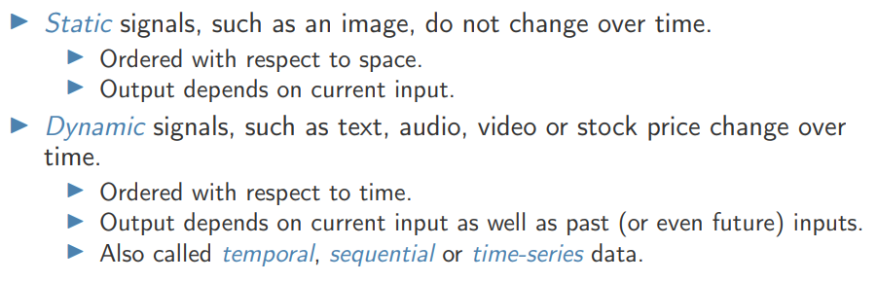
Input types

Slide 4
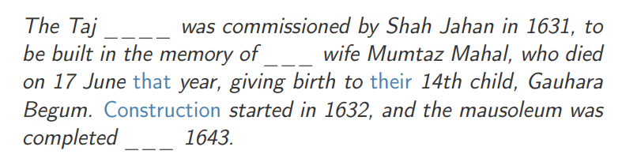
Context in text

Slide 5
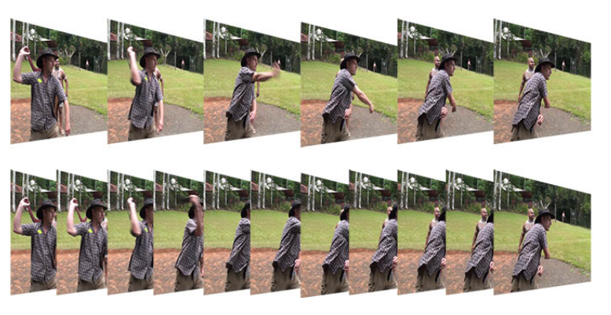
Context in video

Slide 6
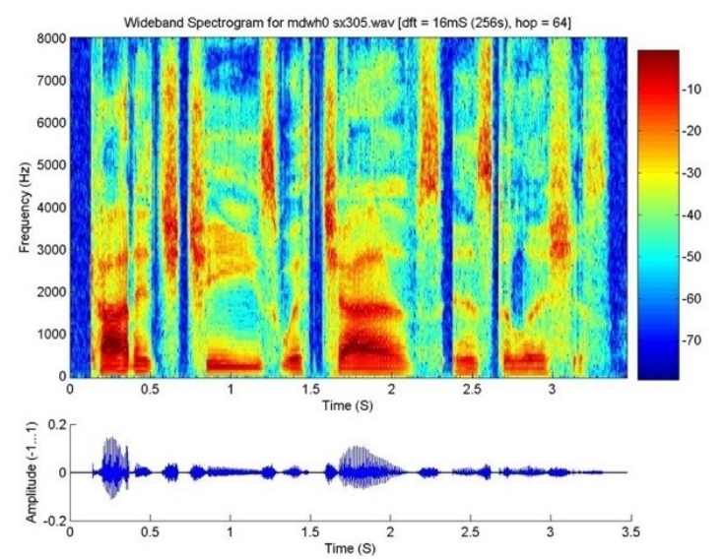
Context in audio

Slide 7

RECURRENT NETWORKS
Introduction
Suppose we want to predict tomorrow’s stock market’s average y(t+1)
Suppose we want the prediction to be based on today’s and yesterday’s economic indicators x_{i}(t) & x_{i}(t-1)
In this case we can have as many input neurons as the number of known elements in the data

Slide 8
RECURRENT NETWORKS
Introduction
However, if we wish the network to consider an arbitrary-sized window of time in the past (e.g. sometimes two days, sometimes 20 days), then a different solution is required
Why not a standard network?

Slide 9







Why not a standard neural network?
$$x^{<1>}$$
$$y^{<1>}$$
$$x^{<2>}$$
$$y^{<2>}$$
$$⋮$$
$$⋮$$
$$⋮$$
$$⋮$$
$$x^{<T_{x}>}$$
$$y^{<T_{y}>}$$
Problems:
- Inputs, outputs can be different lengths in different examples.
- Doesn’t share features learned across different positions of text.

Slide 10
RECURRENT NETWORKS
Introduction
However, if we wish the network to consider an arbitrary-sized window of time in the past (e.g. sometimes two days, sometimes 20 days), then a different solution is required
The recurrent networks provide one such solution
They are used to learn sequential or time-varying patterns, in which the current value of the pattern is dependent upon its past history
Elman, 1990

Slide 11
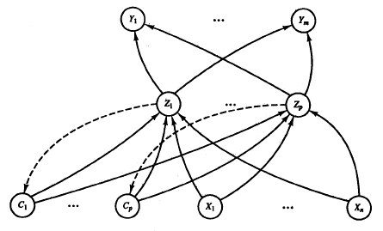
RECURRENT NETWORKS
Architecture
A specific group of units receives feedback signals from the previous time step
These units are known as context units
The weights on the feedback connections to the context units are fixed (e.g. 1)

Slide 12
RECURRENT NETWORKS
Architecture
Context unit is feed-forward connected to its hidden unit & all other hidden unit
Number of context units = number of hidden units
One hidden unit has feedback connection to one context unit only
At time t, the activations of the context units are the activations (output signals) of the hidden units at the previous time step

Slide 13
RECURRENT NETWORKS
Architecture

Slide 14
example
Input sequence i length is 9

Slide 15
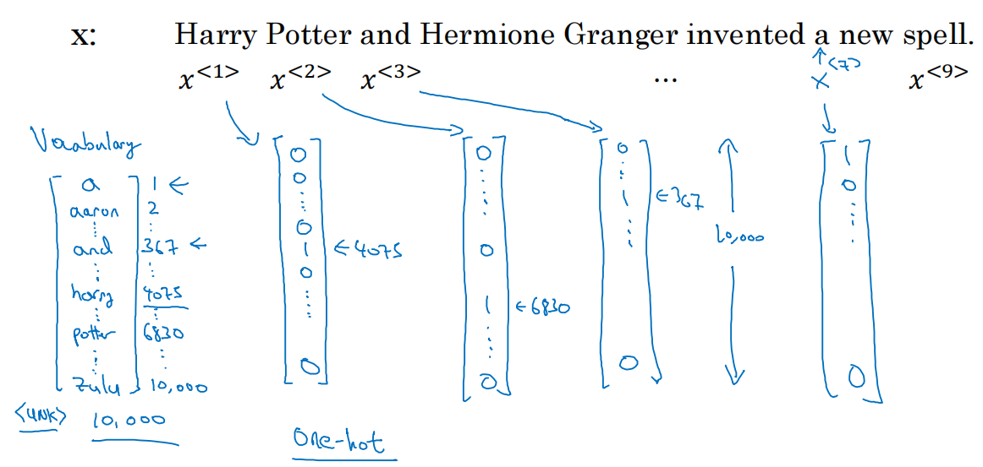
Representing words
And = 367
Invented = 4700
A = 1
New = 5976
Spell = 8376
Harry = 4075
Potter = 6830
Hermione = 4200
Gran… = 4000
Notes:
Vocab , One hot

Slide 16
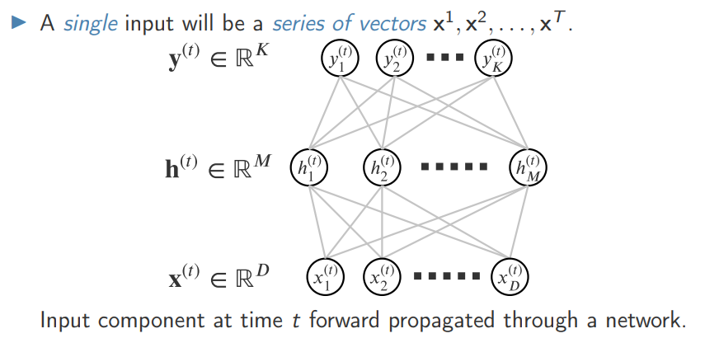
Time series data

Slide 17













Forward Propagation
$${\hat{y}}^{<1>}$$
$${\hat{y}}^{<2>}$$
$${\hat{y}}^{<3>}$$
$${\hat{y}}^{<T_{y}>}$$
$$a^{<1>}$$
$$a^{<2>}$$
$$a^{<T_{x}−1>}$$
$$a^{<0>}$$
$$⋯$$
$$x^{<1>}$$
$$x^{<2>}$$
$$x^{<3>}$$
$$x^{<T_{x}>}$$

Slide 18
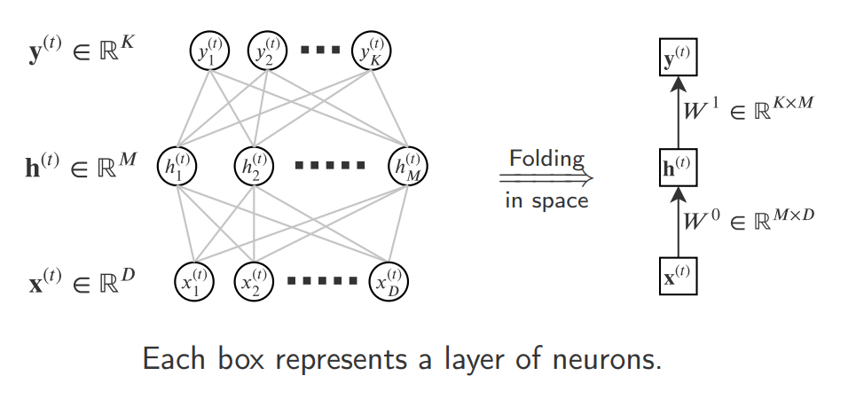
Representational shortcut – folding in space

Slide 19
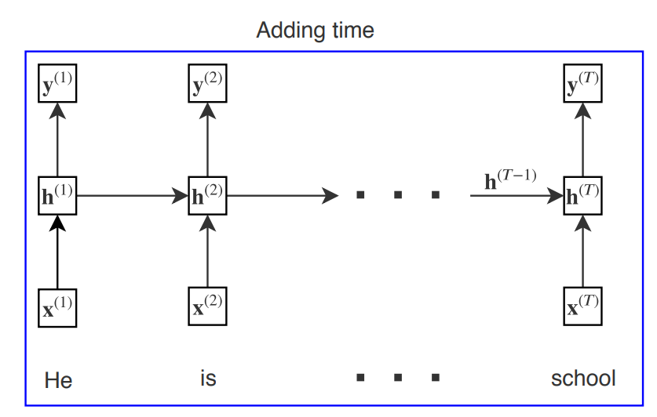
Recurrent neural network
A recurrent neural network (RNN) makes hidden state at time t directly dependent on the hidden state at time t-1 and therefore indirectly on all previous times.
Output y^t depends on all that the network has already seen so far

Slide 20
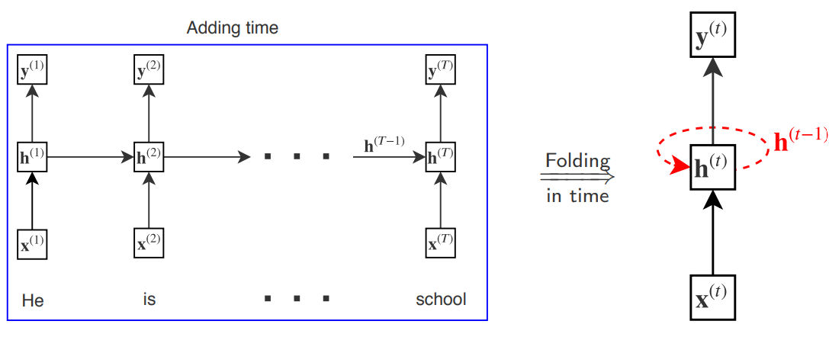
Representational shortcut – folding in time

Slide 21
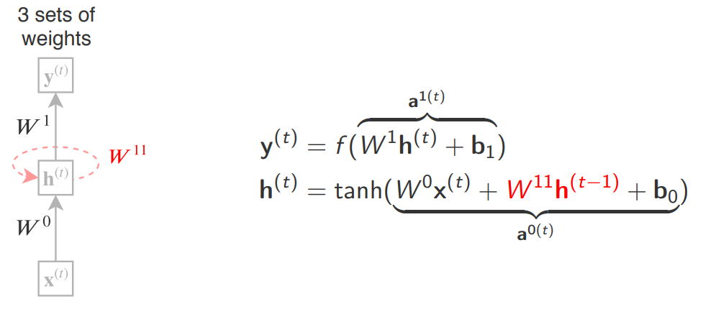
Recurrent neural network

Slide 22
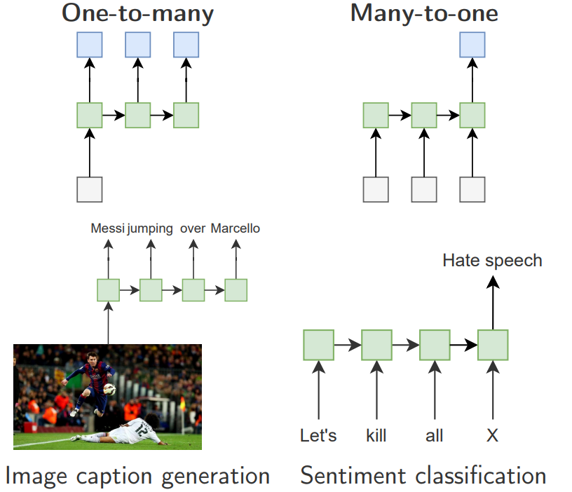
Sequence mappings

Slide 23
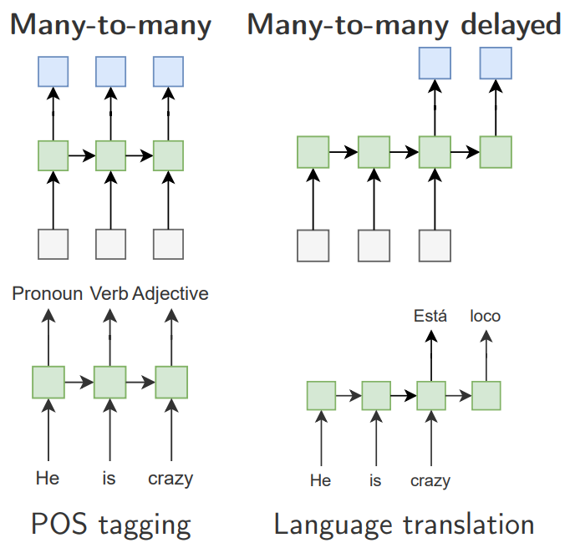
Sequence mappings

Slide 24
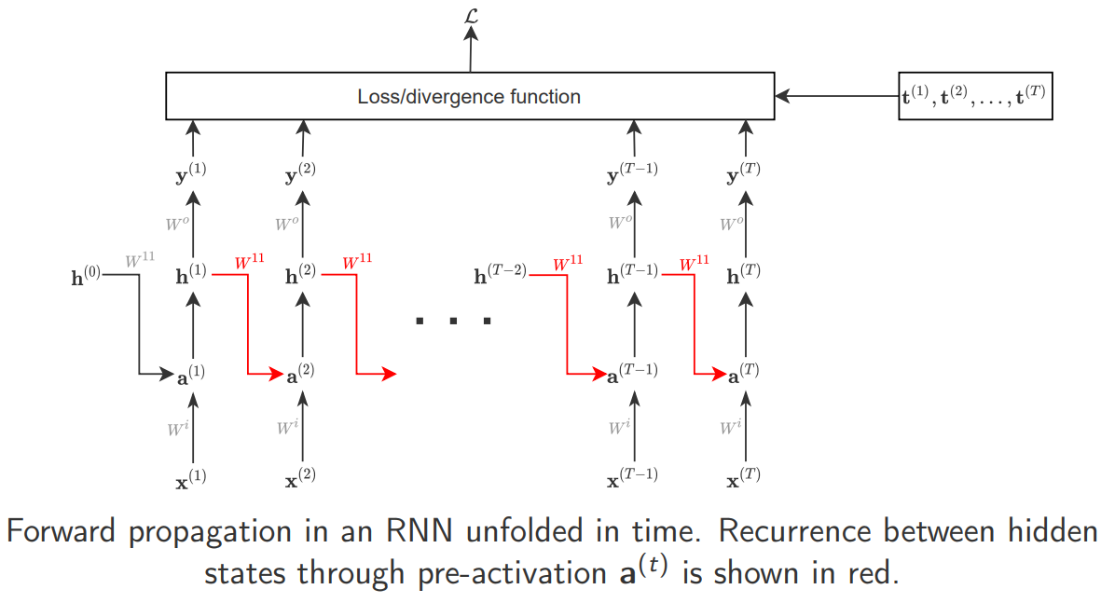
Forward propagation through time

Slide 25
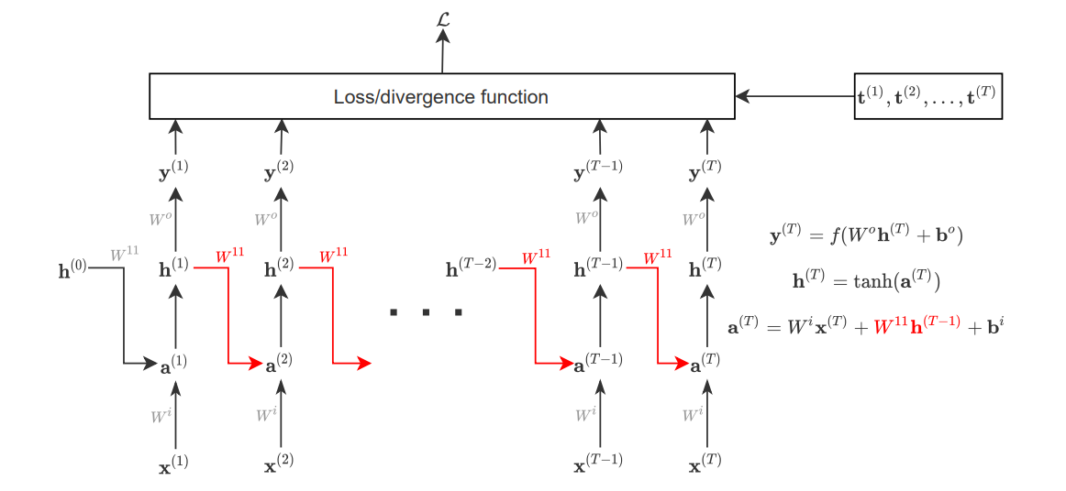
Forward propagation through time

Slide 26
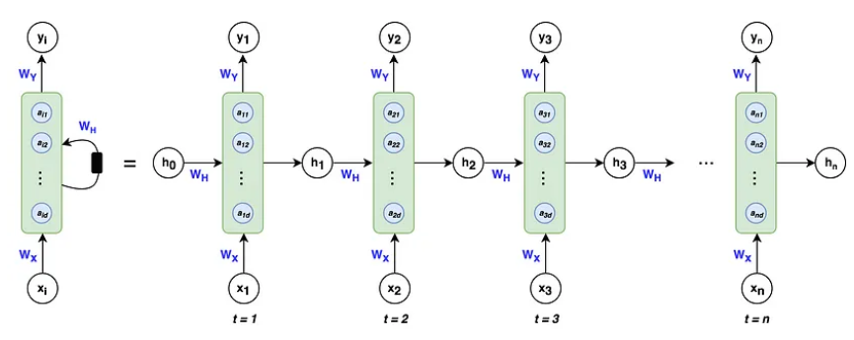
Similar other notations

Slide 27
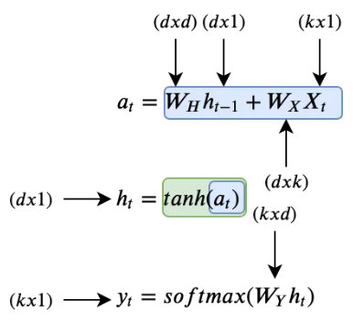
Vector dimensions

